Slide 1
ADP Case Study
Saptarshi Chakraberty

Slide 2

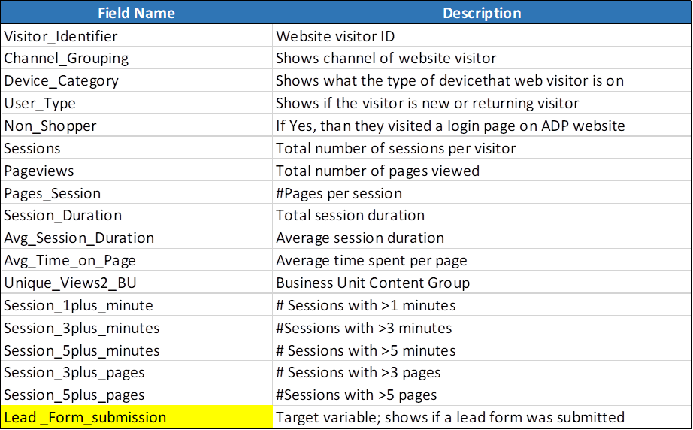
Background and data description
ADP’s Digital team tracks behavior of web visitors on ADP.com website. The given data gives information about web activity of the online visitors sourced from Paid Search over a month.
Below are the data fields and their brief descriptions
2

Slide 3
E2E Path to analyze the case study
Finding patterns of the behavior of visitors
With respect to average time on page
With respect to average session time
Data Pre-processing
Descriptive statistics (Part I & Part II)
Data cleaning ( Part I & Part II)
Model Development
Logistic regression
K-Nearest Neighbors
AdaBoostClassifier
BaggingClassifier
GradientBoostingClassifier
RandomForestClassifier
XgBoost
Decision Tree Classifier
3

Slide 4
Key information derived from raw data
There are no missing value in the dataset.
We have 17 independent variables. Channel_Grouping, Device Category (Desktop: 26938, Mobile: 20253, Tablet: 2229), non_shoper (Yes: 3556, No: 45864), user_type (Returning: 8849, New Visitor: 40571) are the categorical variables.
For the Lead_form_submission, the target variable, we have the ratio of 0:1 is 47615:1805.
session_duration is derived as (Avg_session_duration * sessions) and page view is derived as (Pages_session * sessions), so we dropped those two redundant columns.
Click here to return to home page
4

Slide 5
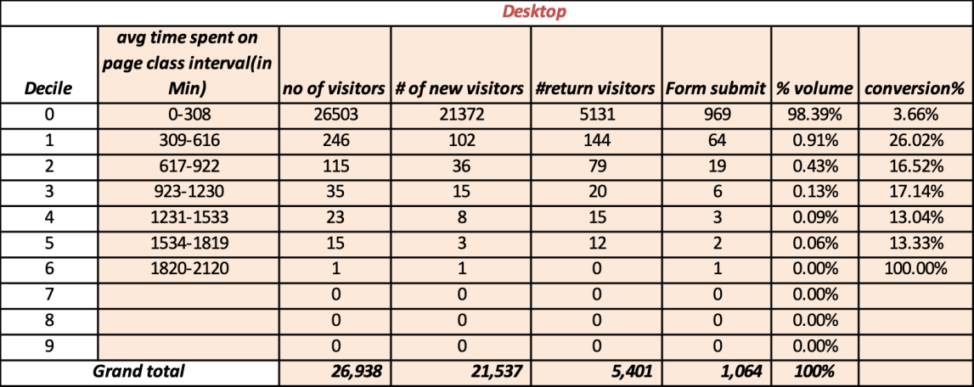
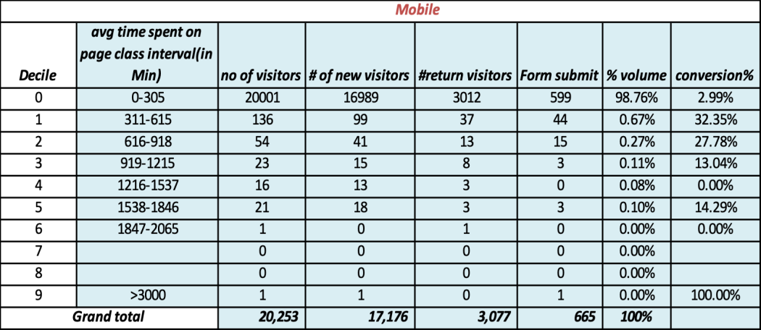
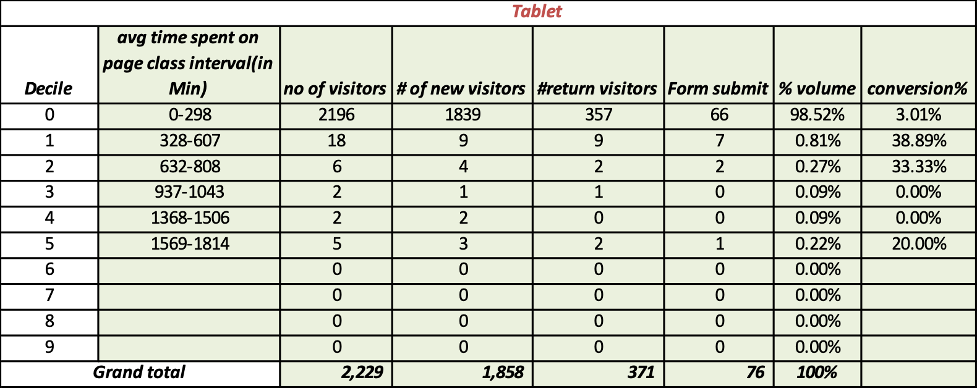
Identifying patterns in the data with respect to average time spent on page
We have divided the average time spent per page in to 10 deciles to understand the pattern of the behavior of the visitors. We wanted to understand the volume and conversion rate** for each of the device categories.
Observation:
Desktop (26938) and Mobile (20253) contributes to 95.4% of the visitors.
Desktop has the highest %-age of returning visitors (20%), followed by Tablet (16%) and Mobile (15.19%).
Inference:
Across all the devices the first 3 deciles include 99.9% of the data, so for further analysis we are limiting only to the first 3 deciles for average time spent per page.
We only have data for a single month, in case of availability of data from other months, a trend analysis might have given an insight if there is any drop on %-age of returning visitors.
** Conversion Rate= Form Submit / # of visitors .
Click here to return to home page
5

Slide 6
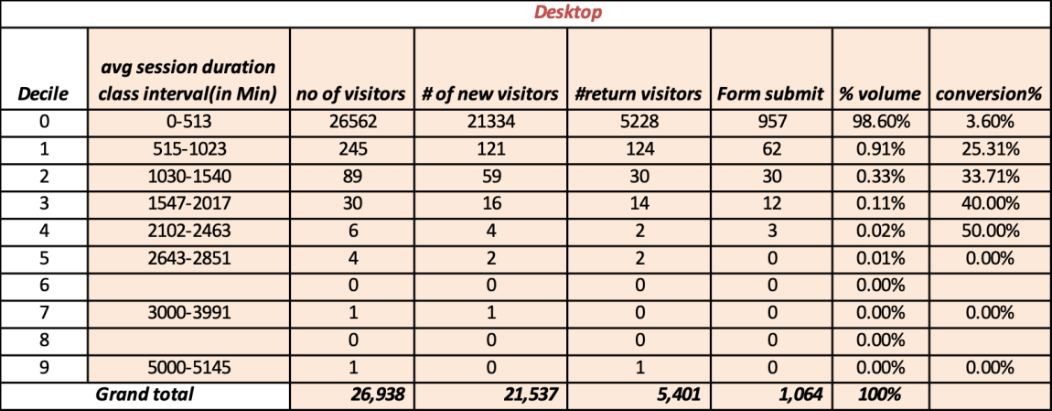

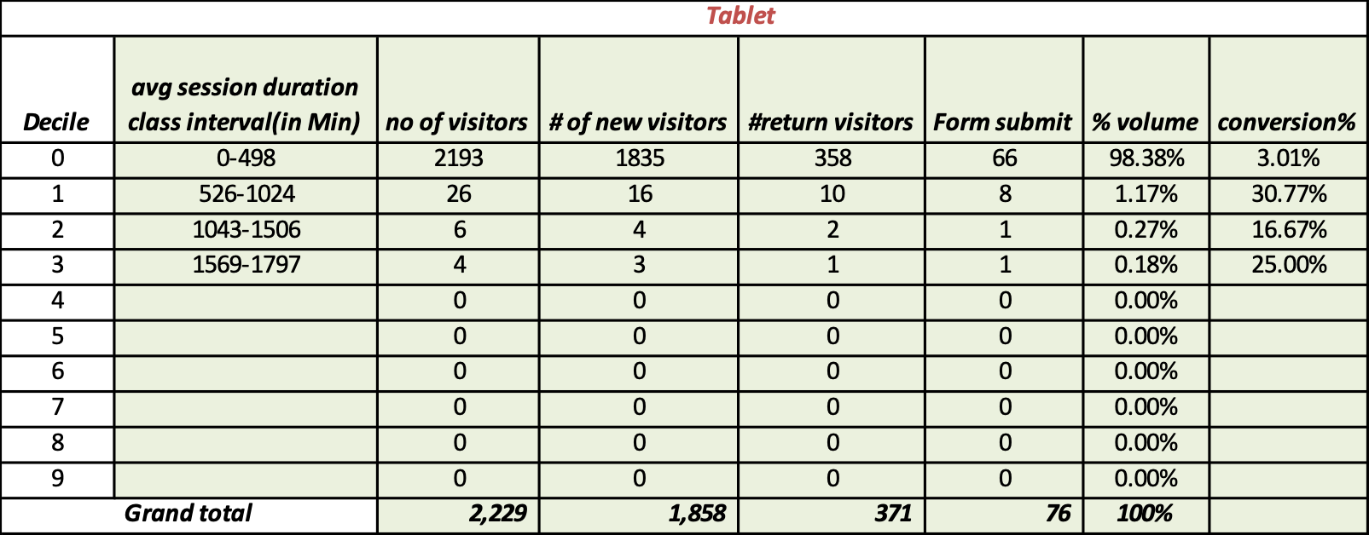
Identifying patterns in the data with respect to average session duration
We have divided the average session duration in to 10 deciles to understand the pattern of the behavior of the visitors. We wanted to understand the volume and conversion rate** for each of the device categories.
Observation:
Desktop has the highest %-age of form submission (3.94%), followed by Tablet (3.40%) and Mobile (3.28%).
Inference:
Across all the devices the first 3 deciles include 99.5% of the data, so for further analysis we are limiting only to the first 3 deciles for average time spent per page.
We only have data for a single month, in case of availability of data from other months, a trend analysis might have given an insight if there is any trend in average session duration over months.
** Conversion Rate= Form Submit / # of visitors .
Click here to return to home page
6

Slide 7
Key information derived from raw data
After limiting ourselves to the data with the first 3 deciles of both avg_session_deciles and avg_time_deciles, we retained 99.6% of the total data.
Once the data was fine tuned, we dropped the derived columns (avg_session_deciles, avg_time_deciles). Dimension for the modified dataset is (49316 X 14), with 1766 1s.
Plotting the Avg_Session_Duration, avg_time_on_page and Session_1plus_minute showed a very highly right-skewed plot.
We tried to log-transform Avg_Session_Duration, avg_time_on_page, but found out over 90% of the values are 0. So, we added a perturbation of 1 unit to the variables and then log-transformed them.
Click here to return to home page
7

Slide 8
Journey towards model development: Data cleaning Part I
Plot of the log-transformed perturbed values showed improvement but still it has two peaks and for further research one can explore for some transformation to convert it to a bell-shaped curve and play around to improve the correlation or linear association with the target variable.
After assigning levels to the categorical variables, we calculated the correlation of all the retained independent variables with the target and we found the following:
Avg_Session_Duration 0.35
avg_time_on_page 0.51
Pages_Session 0.33
Session_1plus_minute 0.33
Session_3plus_minutes 0.16
Session_3plus_pages 0.076
Session_5plus_minutes 0.093
Session_5plus_pages 0.057
sessions -0.0061
Unique_Views2_BU 0.084
User_type -0.01
Click here to return to home page
8

Slide 9
Journey towards model development: Data cleaning Part II
Train-test-split: For the final data we divided it into 70-30 split, meaning, we derived our model on 70% of the data and measured the model performance on the 30% of the data, the model has not seen before.
Standardizing: To get rid of any multicollinearity and influential observation, we standardized all the independent variables.
Balancing the data: As the final data does not have equal amount of 0s and 1s, we took the advantage of borderline-SMOTE (Synthetically oversampling the minority) to balanced out the amount of 1s and 0s in the train data and deployed different Classification techniques.
Report for those techniques are presented in the following slides.
Click here to return to home page
9

Slide 10
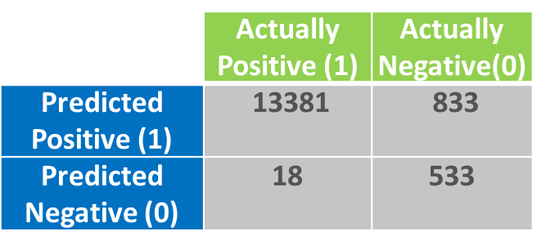
Algorithm Used: Logistic Regression
Features used
All the independent variables were considered
Confusion Matrix
Model Performance KPIs
Accuracy Score: 94.23 %
Precision Score: 39.01 %
Recall Score: 96.73 %
f1_score: 0.55
AUC ROC: 0.95
Click here to return to home page
10

Slide 11

Algorithm Used: K-Nearest Neighbors
Features used
All the independent variables were considered
Confusion Matrix
Model Performance KPIs
Accuracy Score: 96.69 %
Precision Score: 54.54 %
Recall Score: 68.60 %
f1_score: 0.60
AUC ROC: 0.83
Click here to return to home page
11

Slide 12

Algorithm Used: Decision Tree Classifier
Features used
All the independent variables were considered
Confusion Matrix
Model Performance KPIs
Accuracy Score: 96.69 %
Precision Score: 54.54 %
Recall Score: 68.60 %
f1_score: 0.60
AUC ROC: 0.83
Click here to return to home page
12

Slide 13

Algorithm Used: AdaBoostClassifier
Features used
All the independent variables were considered
Confusion Matrix
Model Performance KPIs
Accuracy Score: 94.60 %
Precision Score: 40.54 %
Recall Score: 95.28 %
f1_score: 0.56
AUC ROC: 0.94
Click here to return to home page
13

Slide 14

Algorithm Used: BaggingClassifier
Features used
All the independent variables were considered
Confusion Matrix
Model Performance KPIs
Accuracy Score: 96.93 %
Precision Score: 56.67 %
Recall Score: 75.49 %
f1_score: 0.64
AUC ROC: 0.86
Click here to return to home page
14

Slide 15

Algorithm Used: GradientBoostingClassifier
Features used
All the independent variables were considered
Confusion Matrix
Model Performance KPIs
Accuracy Score: 95.82 %
Precision Score: 47.06 %
Recall Score: 94.73 %
f1_score: 0.62
AUC ROC: 0.95
Click here to return to home page
15

Slide 16

Algorithm Used: RandomForestClassifier
Features used
All the independent variables were considered
Confusion Matrix
Model Performance KPIs
Accuracy Score: 96.97 %
Precision Score: 57.12 %
Recall Score: 76.40 %
f1_score: 0.65
AUC ROC: 0.87
Click here to return to home page
16

Slide 17

Algorithm Used: XgBoost
Features used
All the independent variables were considered
Confusion Matrix
Model Performance KPIs
Accuracy Score: 96.79 %
Precision Score: 54.32 %
Recall Score: 88.92 %
f1_score: 0.67
AUC ROC: 0.93
Click here to return to home page
17

Slide 18
Conclusions:
All the models have very high AUC ROC and accuracies, but in terms of recall Logistic Regression and XgBoost are preferred.
The most usefulness of Logistic regression is that it just not only separates the Target variable, rather it also provides us a quantitative probability measure.
Click here to return to home page
18

Slide 19
Further Research Ideas
Plot of the log-transformed perturbed values for Avg_Session_Duration and avg_time_on_page, still showed a moderate right skewness with two peaks, one can try to identify the occurrence of the two peaks (possibly it is a mixture of two groups).
If a suitable transformation can convert the variables into a bell-shaped plot, one can test the equality of means of Avg_Session_Duration and avg_time_on_page for lead_form_submission yes (Y = 1) and lead_form_submission nos (Y= 0).
Hypothesis testing for equality of proportion of returning visitors for Y= 1 and Y= 0 can be carried out to get some further insight.
One might try to model Session_1plus_minute as a zero-truncated Poisson or some other model that fit good for count variables.
Click here to return to home page
19

